Slide 1
COMPUTER ARCHITECTURE LAB PROJECT
TOPIC 4 & 13
TRAN QUANG HUNG 20226045
TRAN ANH DUNG

Slide 2

MALLOC FUNCTION
TOPIC 4

Slide 3

Engaging the audience

Slide 4
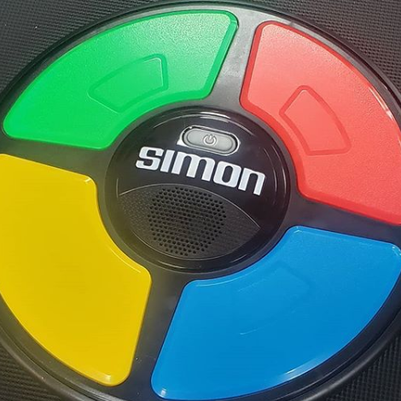
THE SIMON GAME
TOPIC 13

Slide 5
THE SIMON GAME
The Game Starts: The game begins with the device lighting up one of the colored buttons and playing its corresponding sound.
The Player's Turn: The player must then press the same button that lit up, following the same sequence.
Increasing Complexity: With each correct press, the sequence becomes longer by adding one more light to the previous sequence. The game continues to add new elements as long as the player remembers the sequence.
Game Over: If the player makes a mistake by pressing the wrong button or failing to repeat the sequence correctly, the game ends.

Slide 6
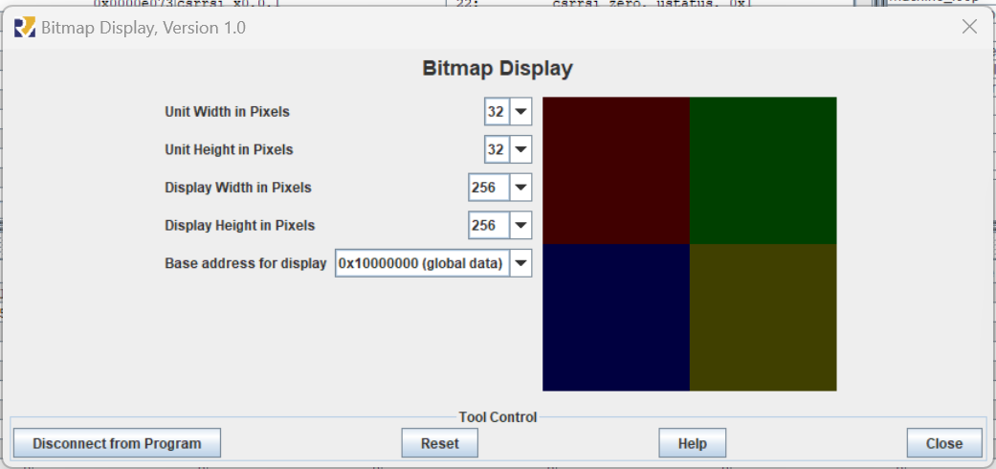
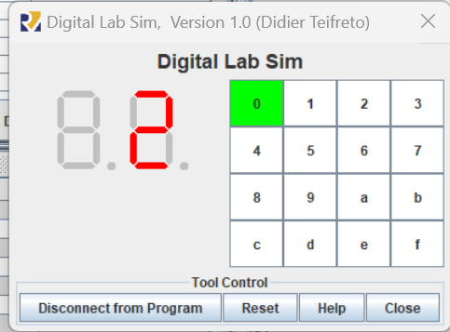


OUR PROGRAM
Using BIT MAP to simulate 4 LED zone.
Using Digital Lab Sim to show score and get user input.

